Slide 1
Unstimulated and Stimulated

Slide 2
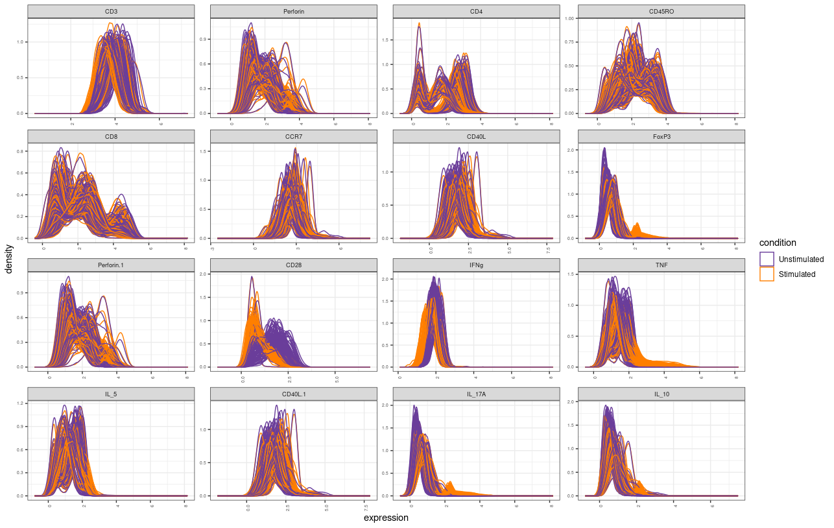

Slide 3
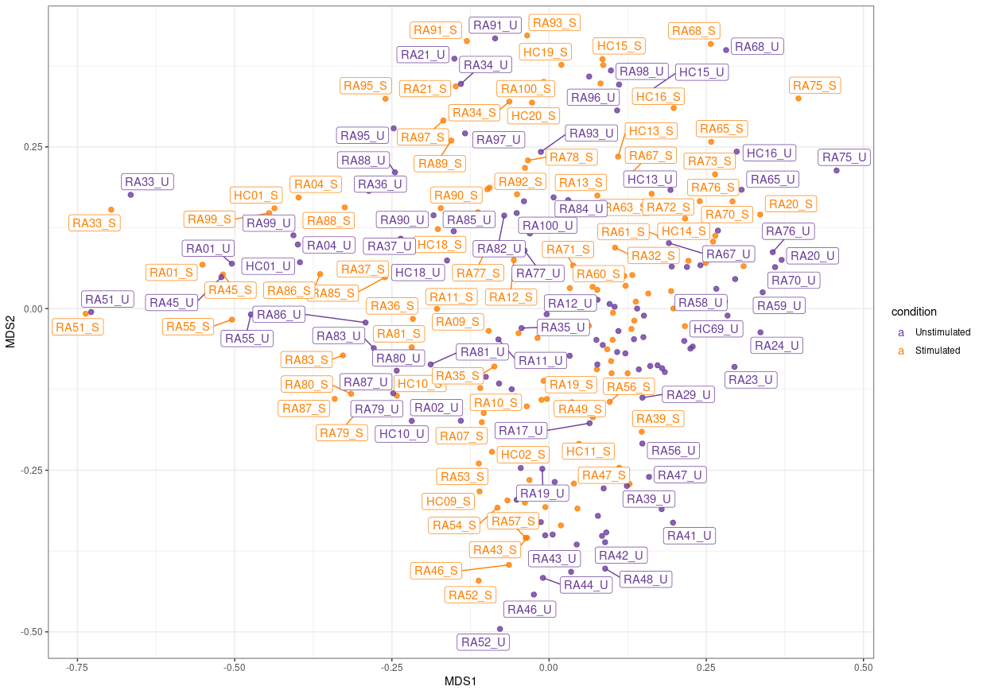

Slide 4
Stimulated (RA-HC)

Slide 5
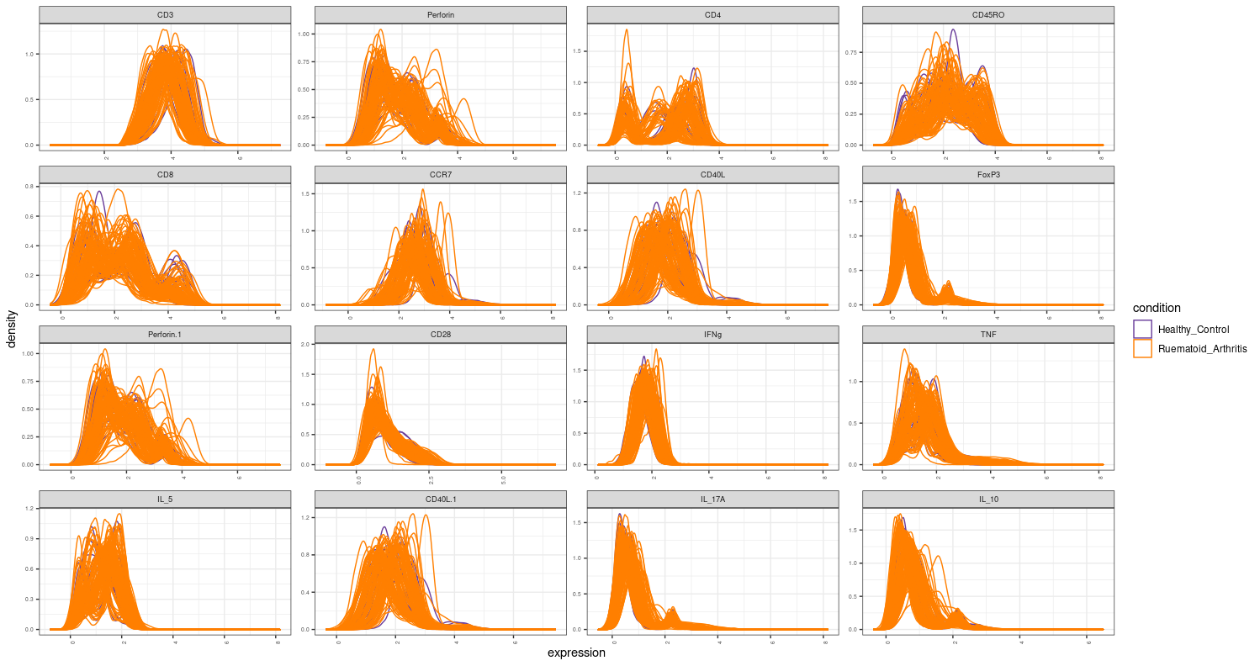

Slide 6
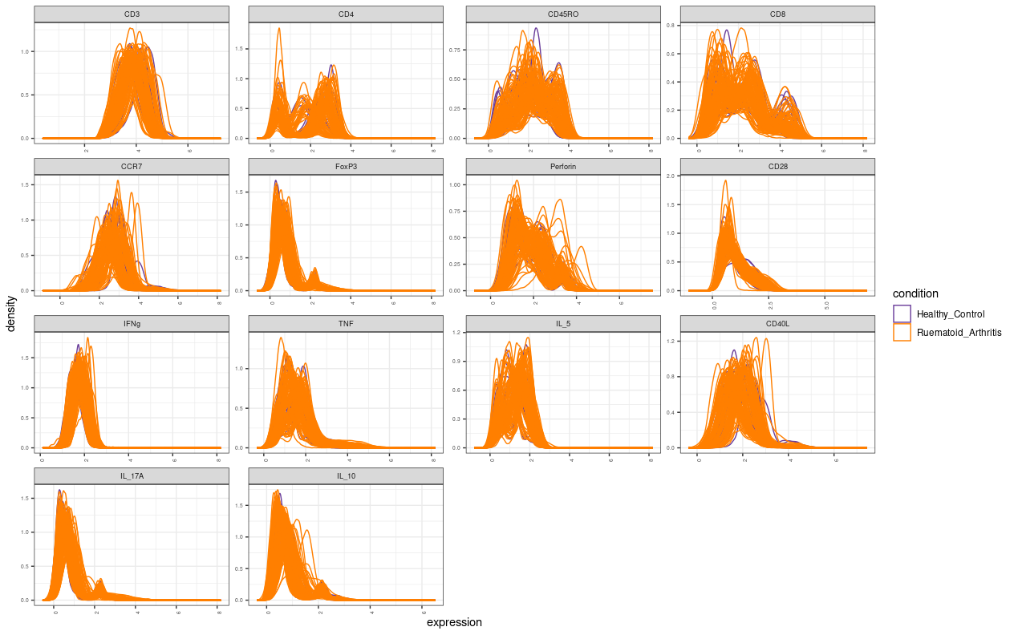
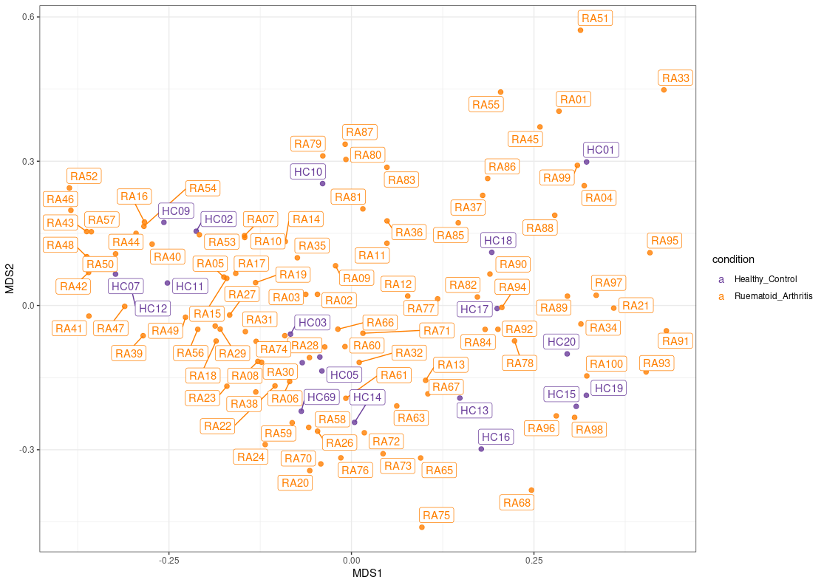

Slide 7
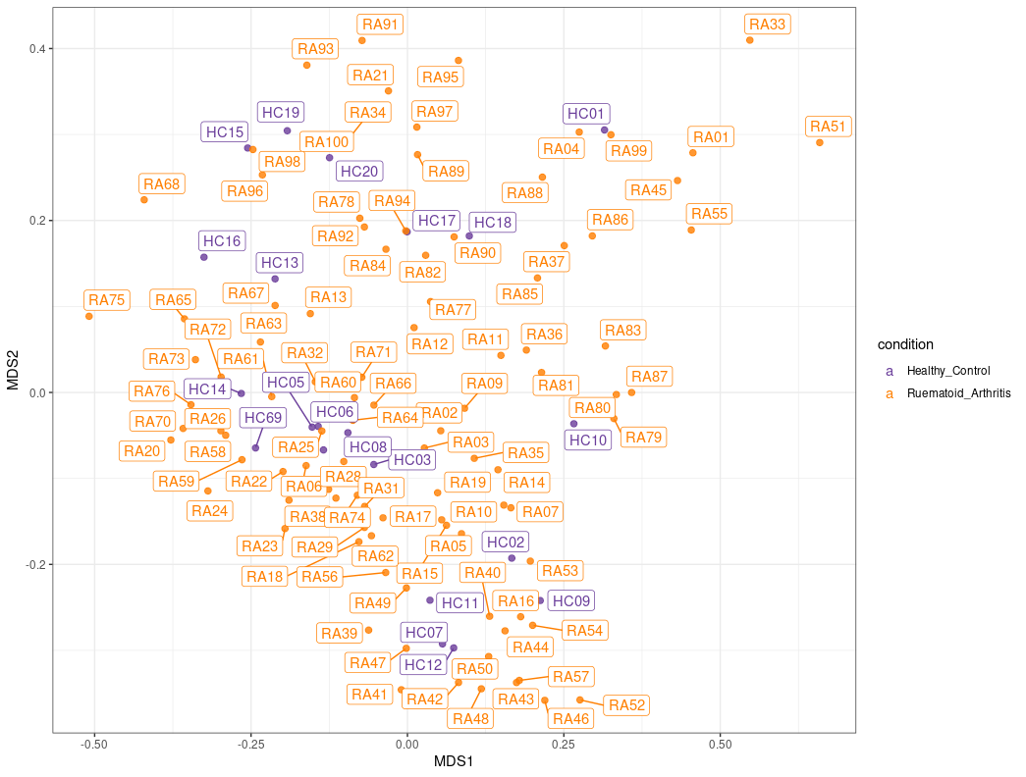

Slide 8
Stimulated(Batch number)

Slide 9
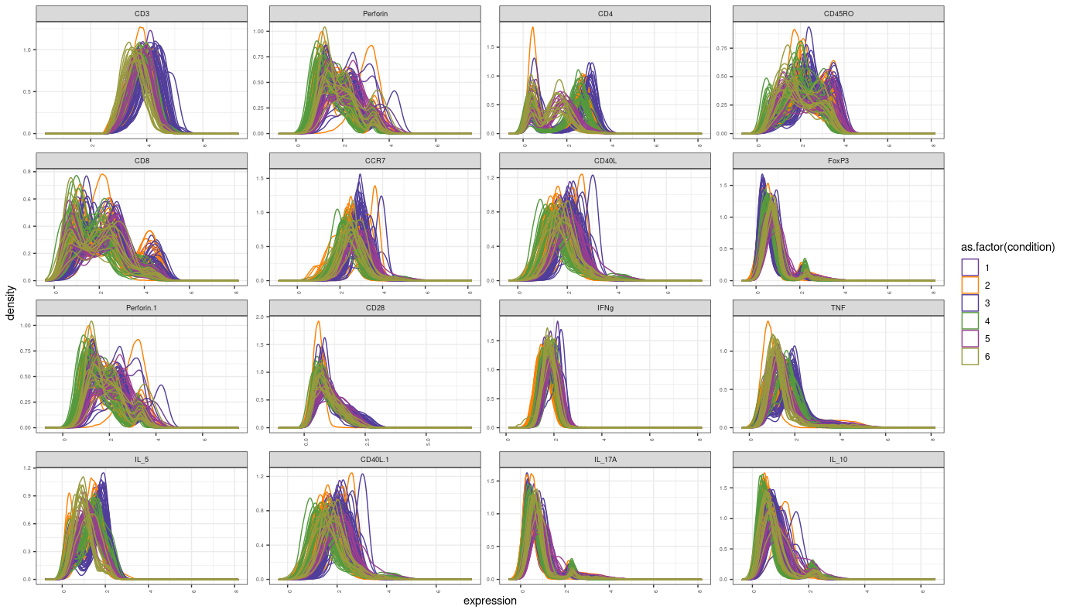

Slide 10
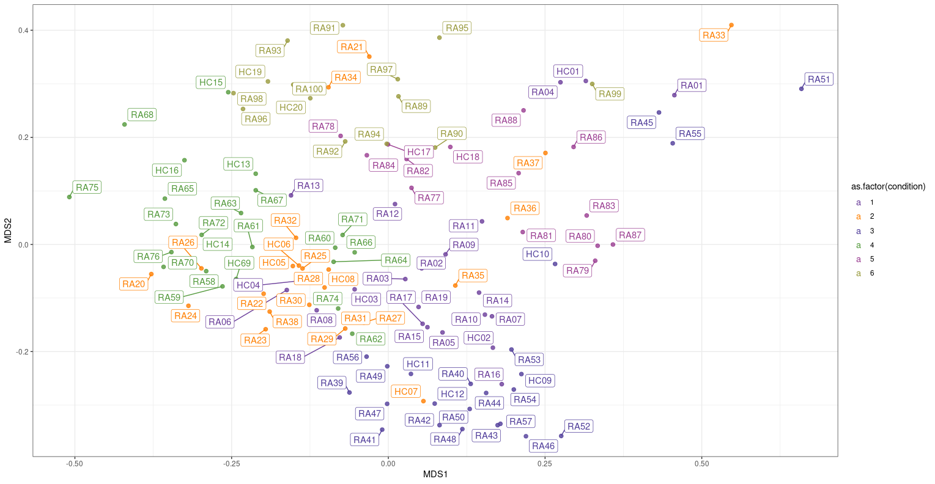

Slide 11
Unstimulated(RA-HC)

Slide 12
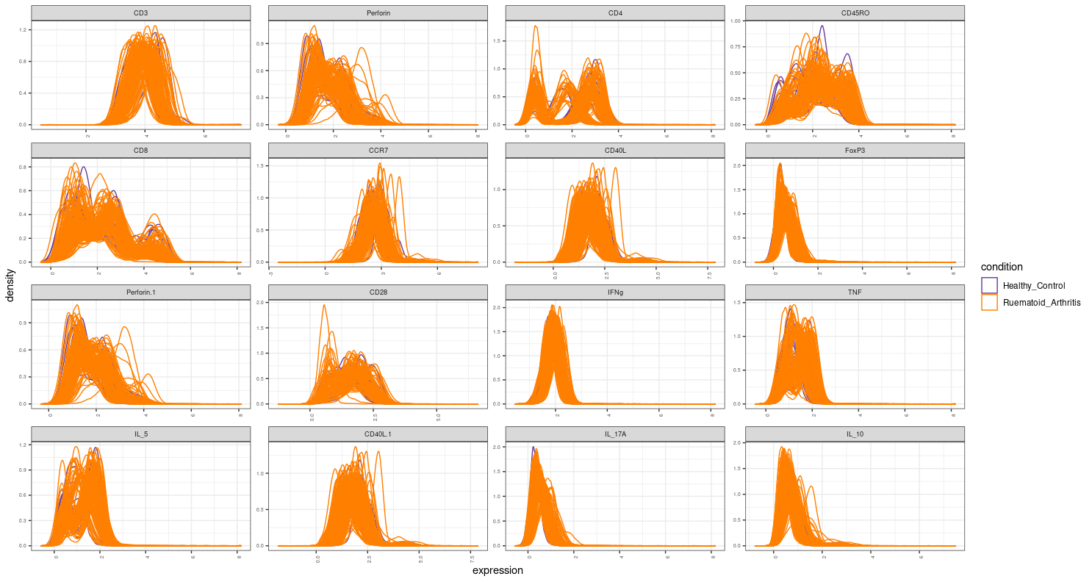

Slide 13
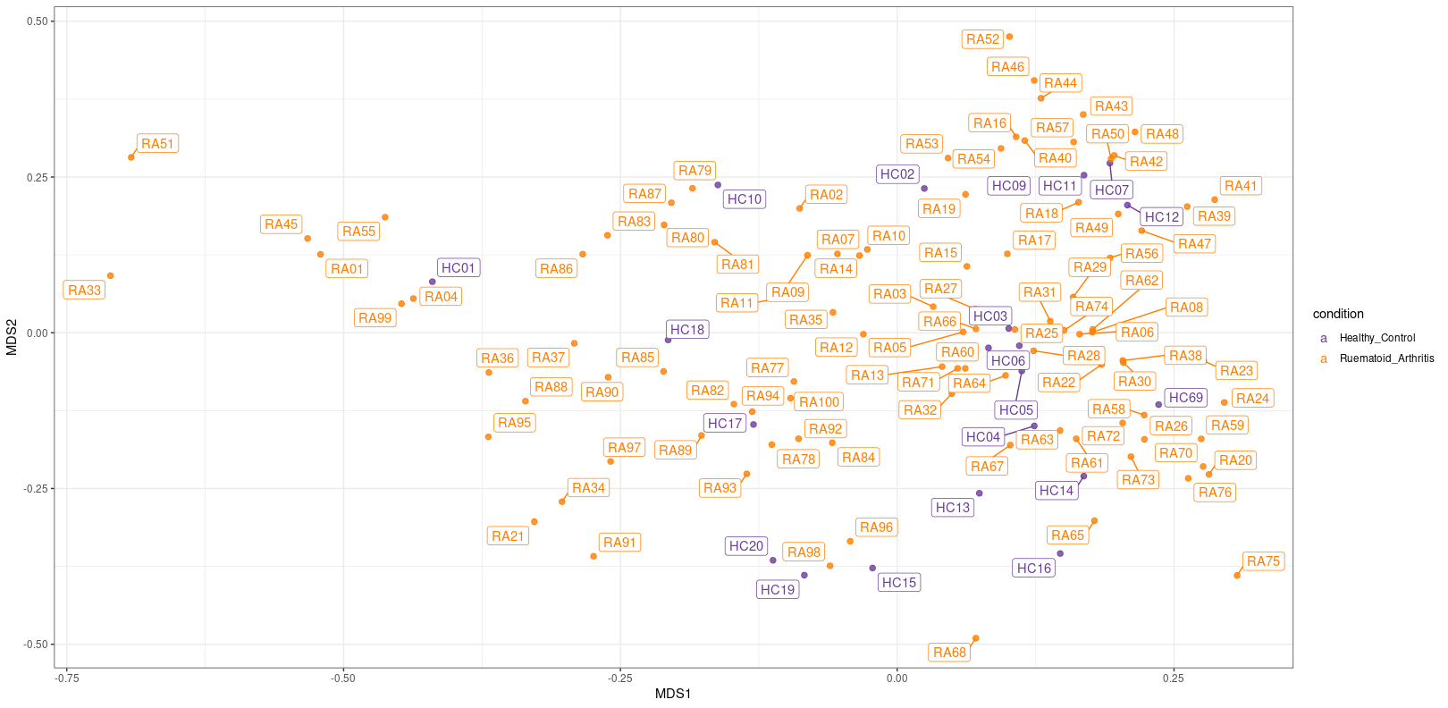

Slide 14
Unstimulated(Batch number)

Slide 15
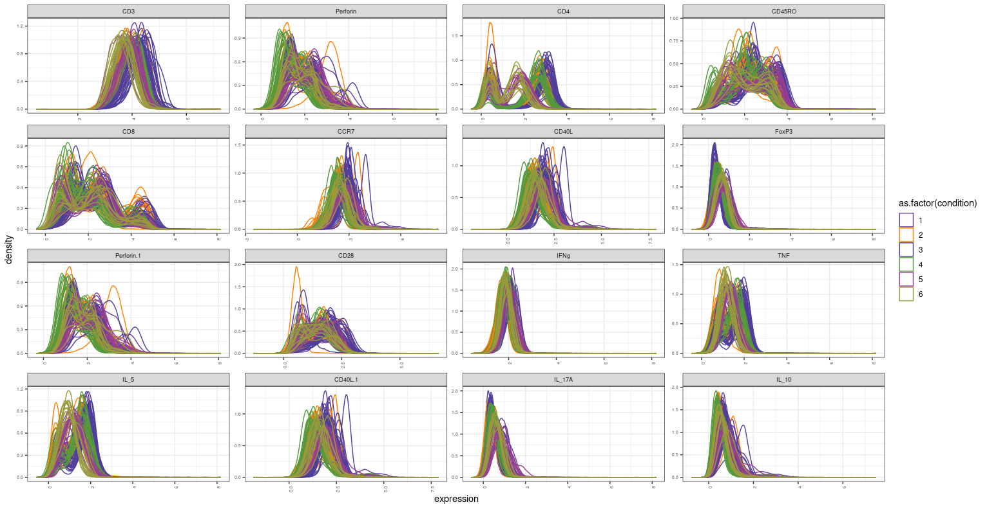

Slide 16
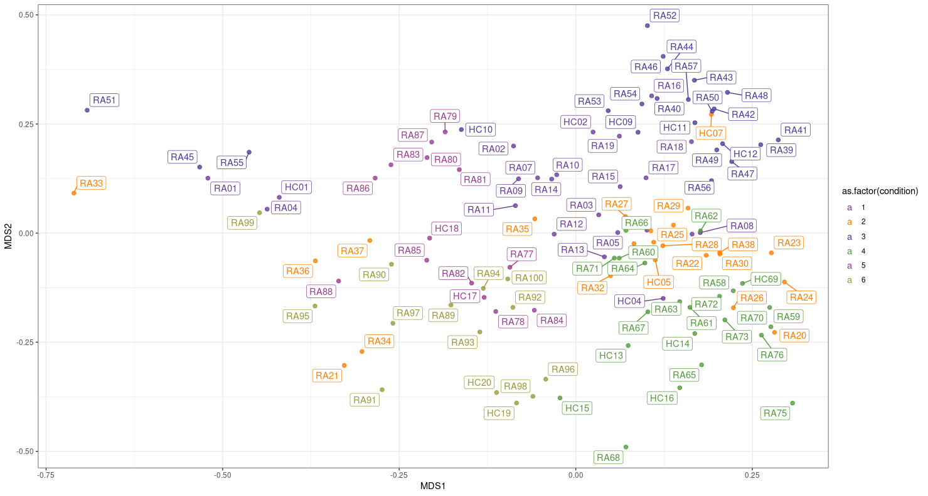

Slide 17
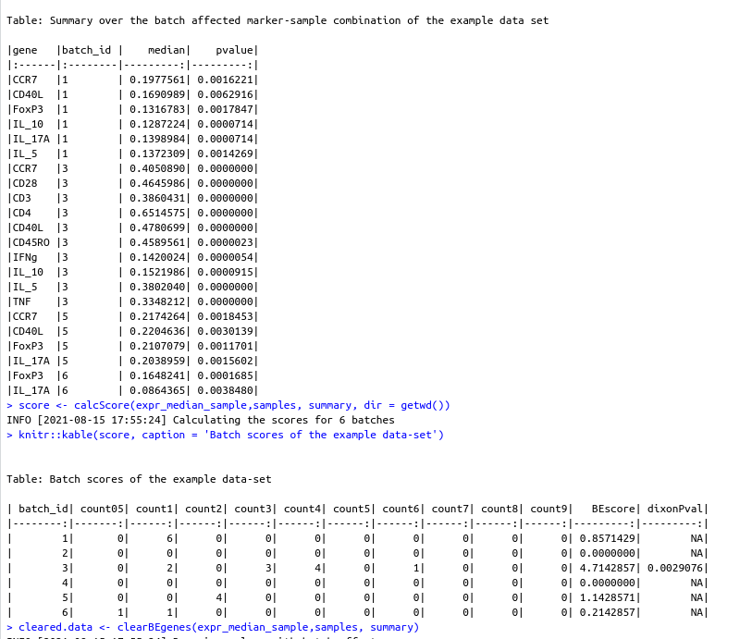

Slide 18
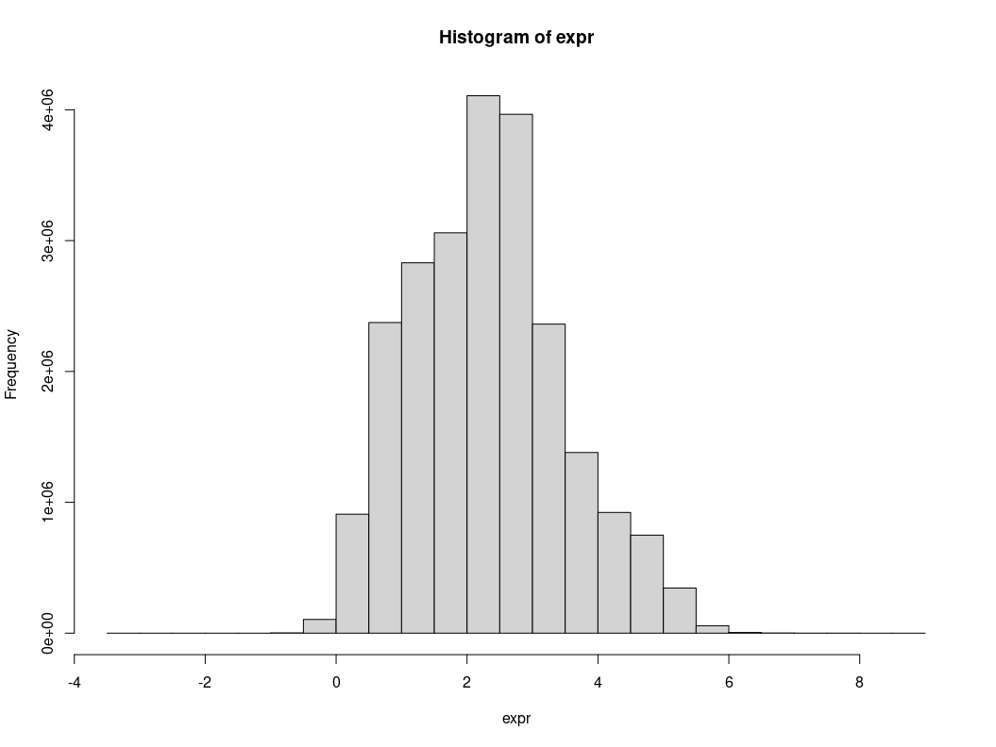
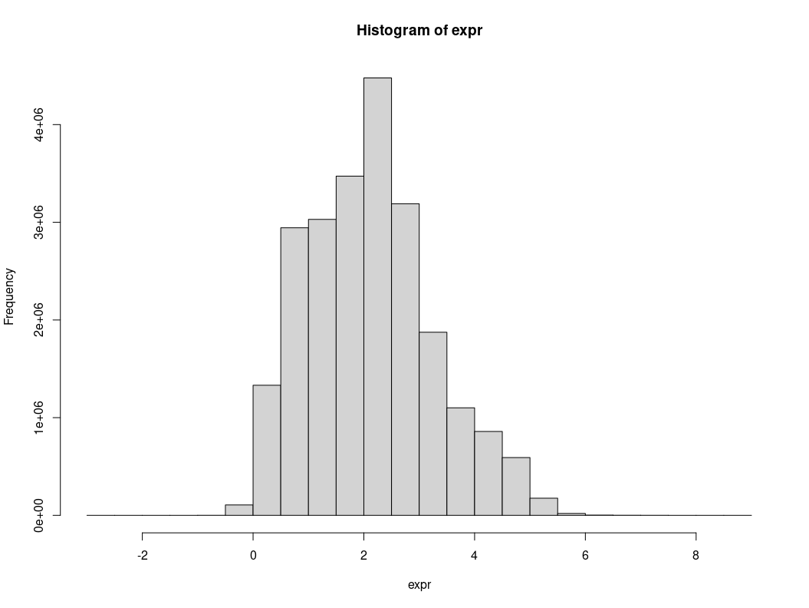
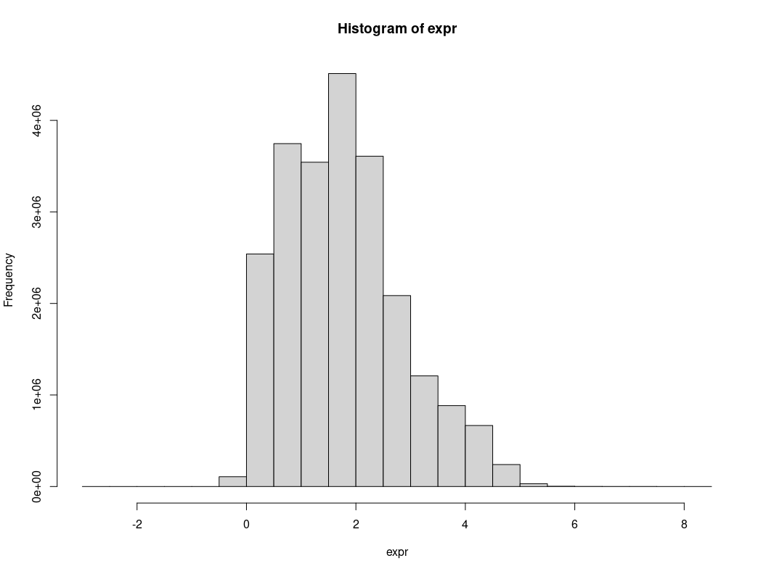
80
100
150

Slide 19
Responers,Non-responders

Slide 20
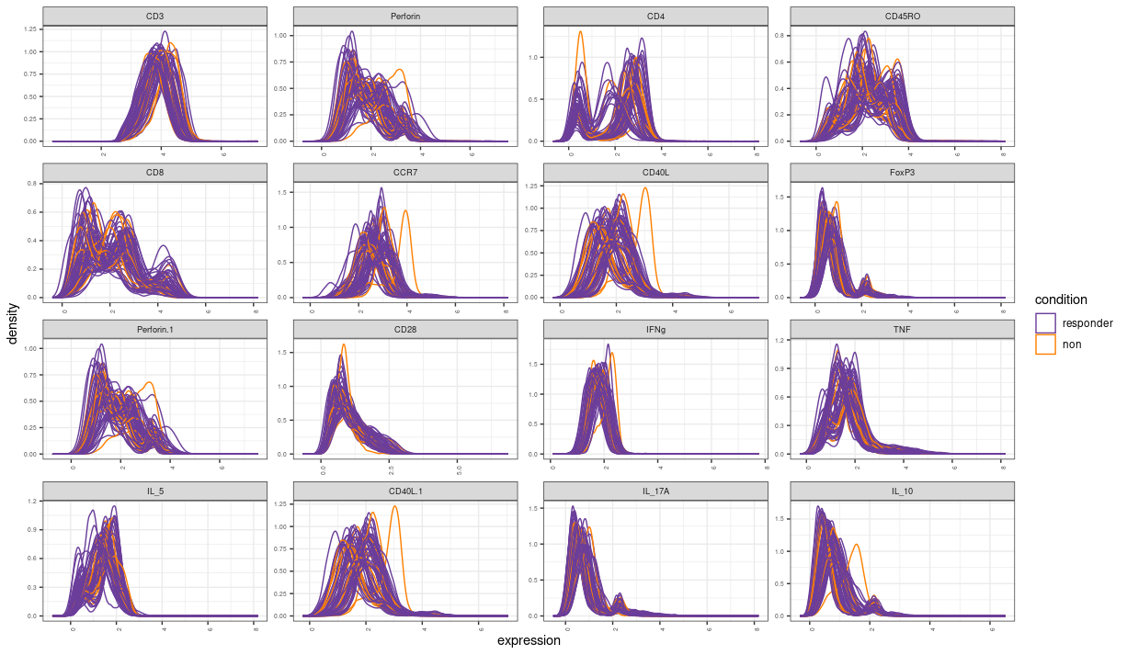

Slide 21
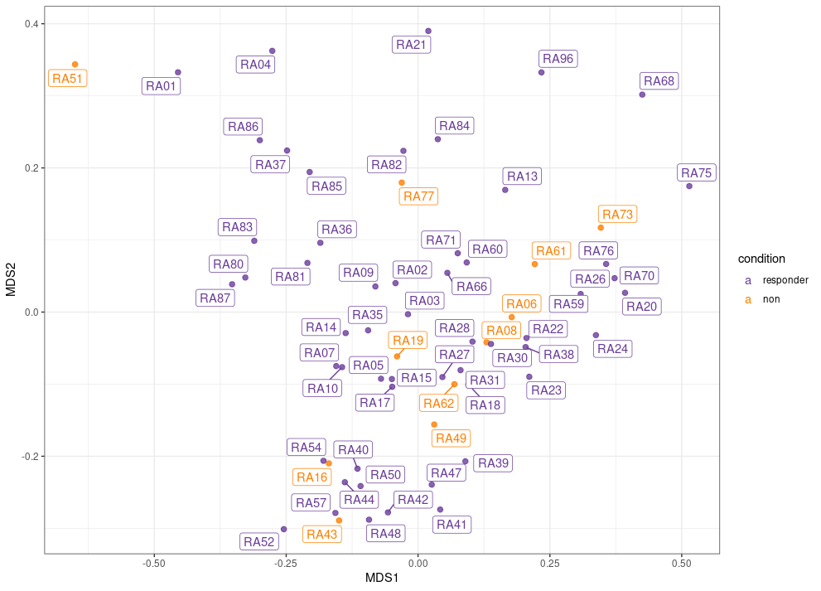

Slide 22
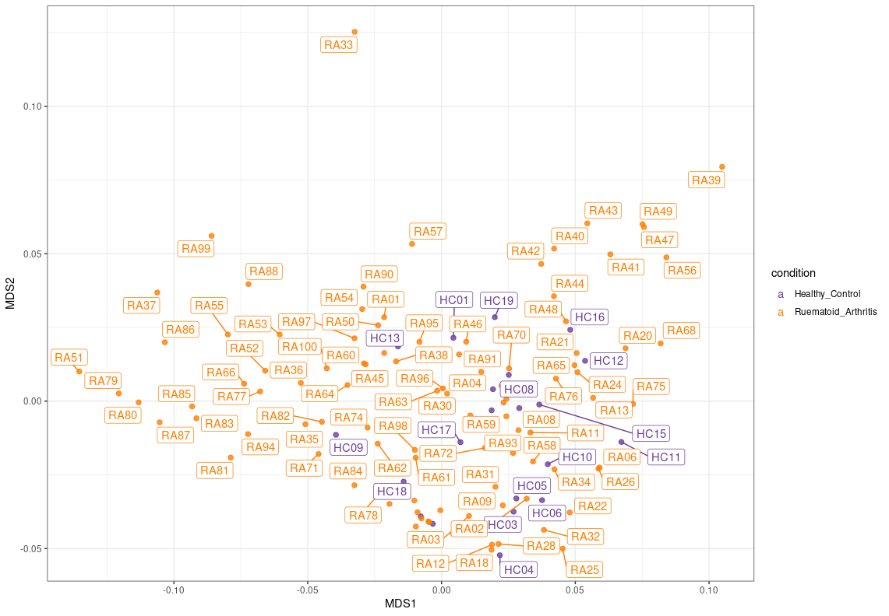
Stimulated(RA/HC)-corrected by Beclear with duplicate columns in expr

Slide 23
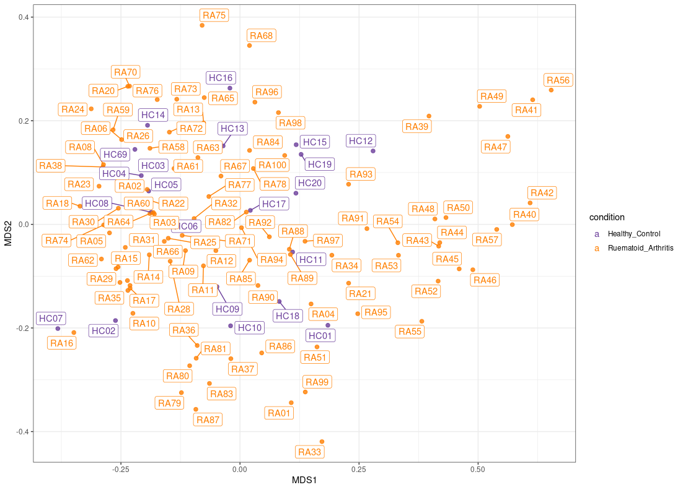
Stimulated(RA/HC)-corrected by Beclear-cleaned expr

Slide 24
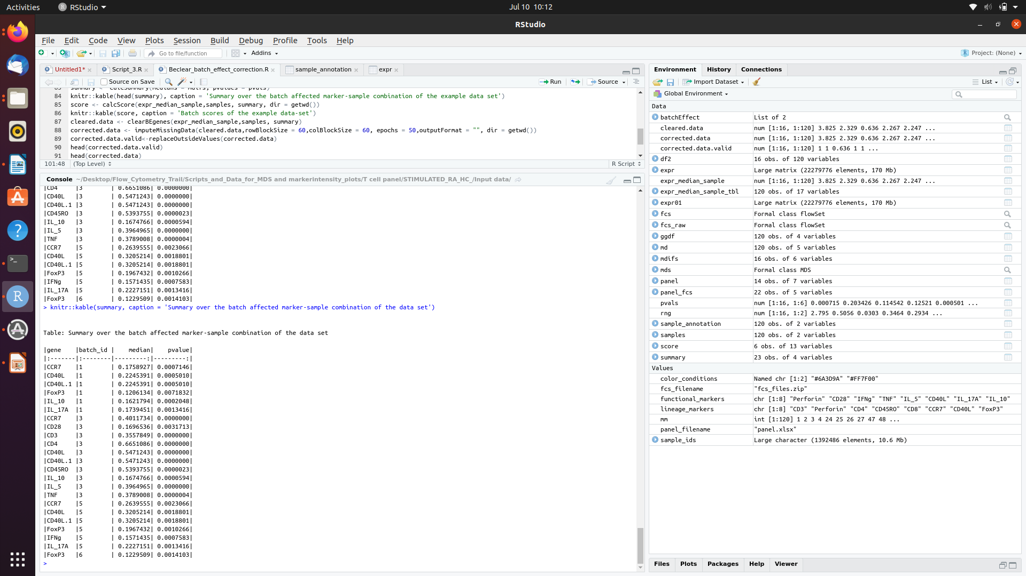
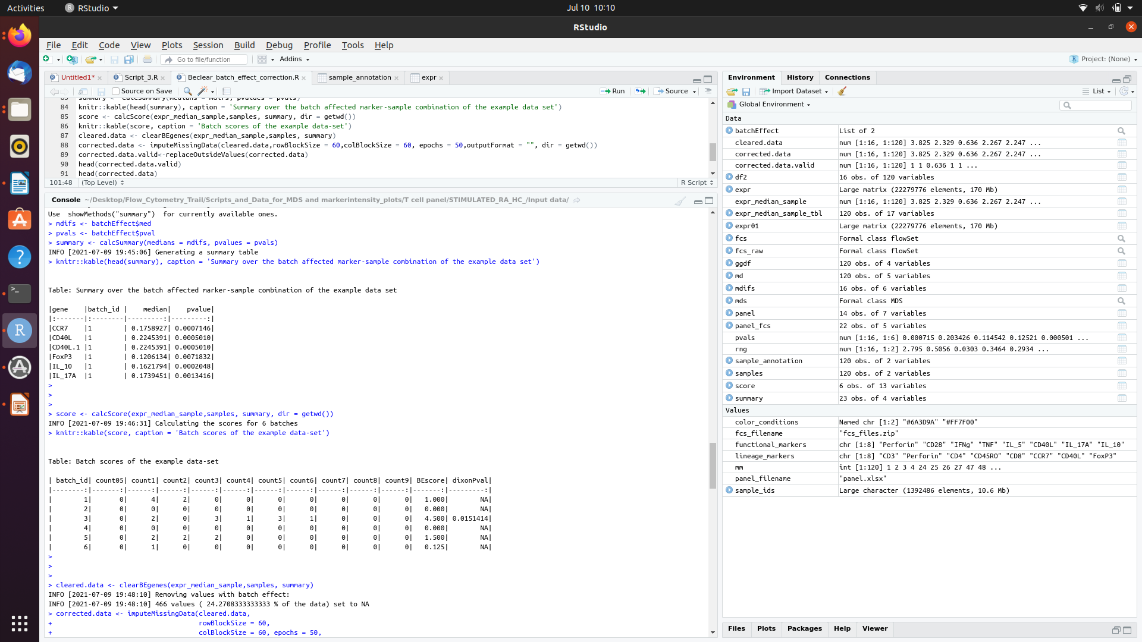

Slide 25
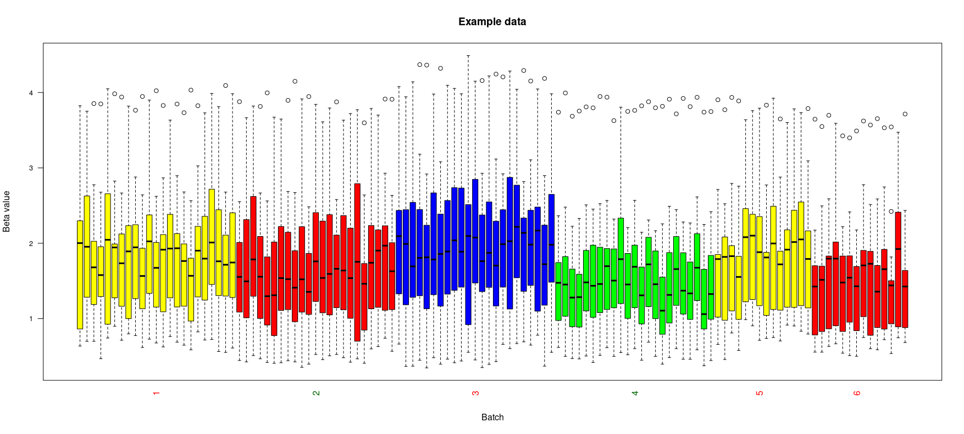
Beclear Before Correction

Slide 26
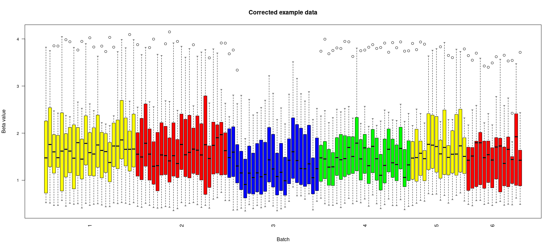
Beclear after correction

Slide 27
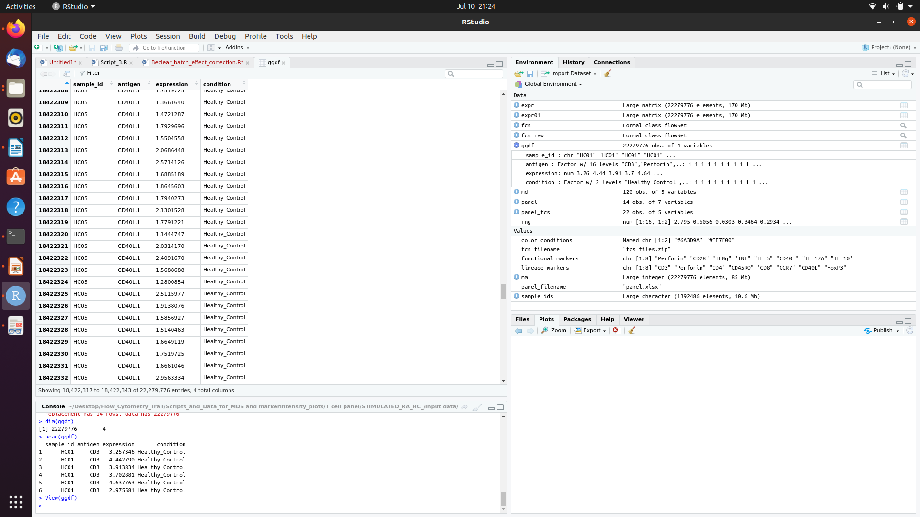

Slide 28
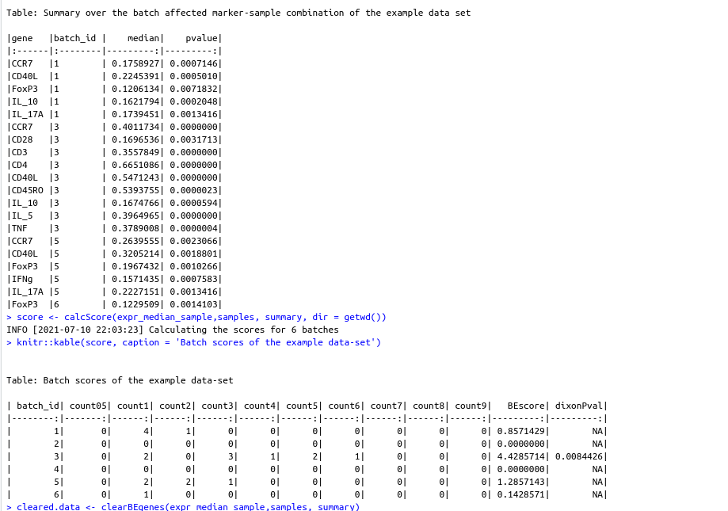

Slide 29
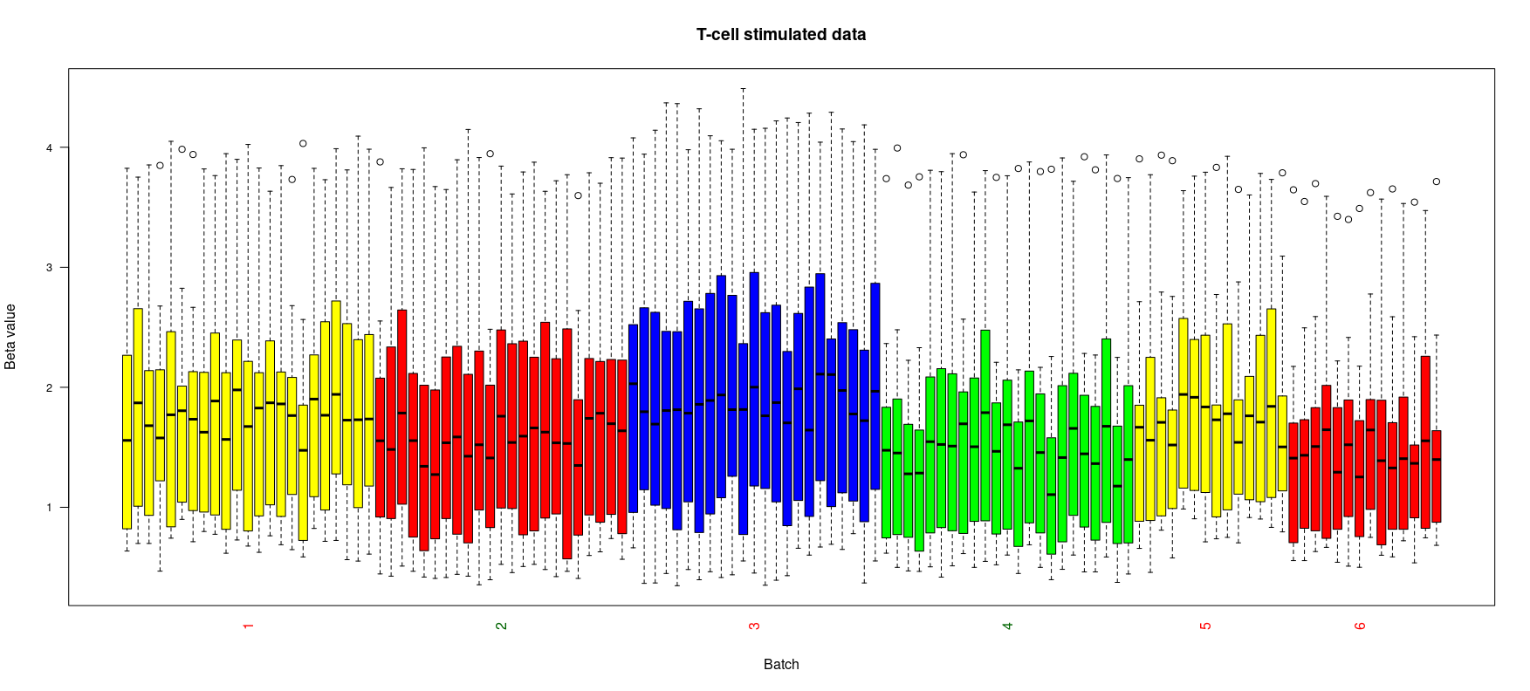

Slide 31
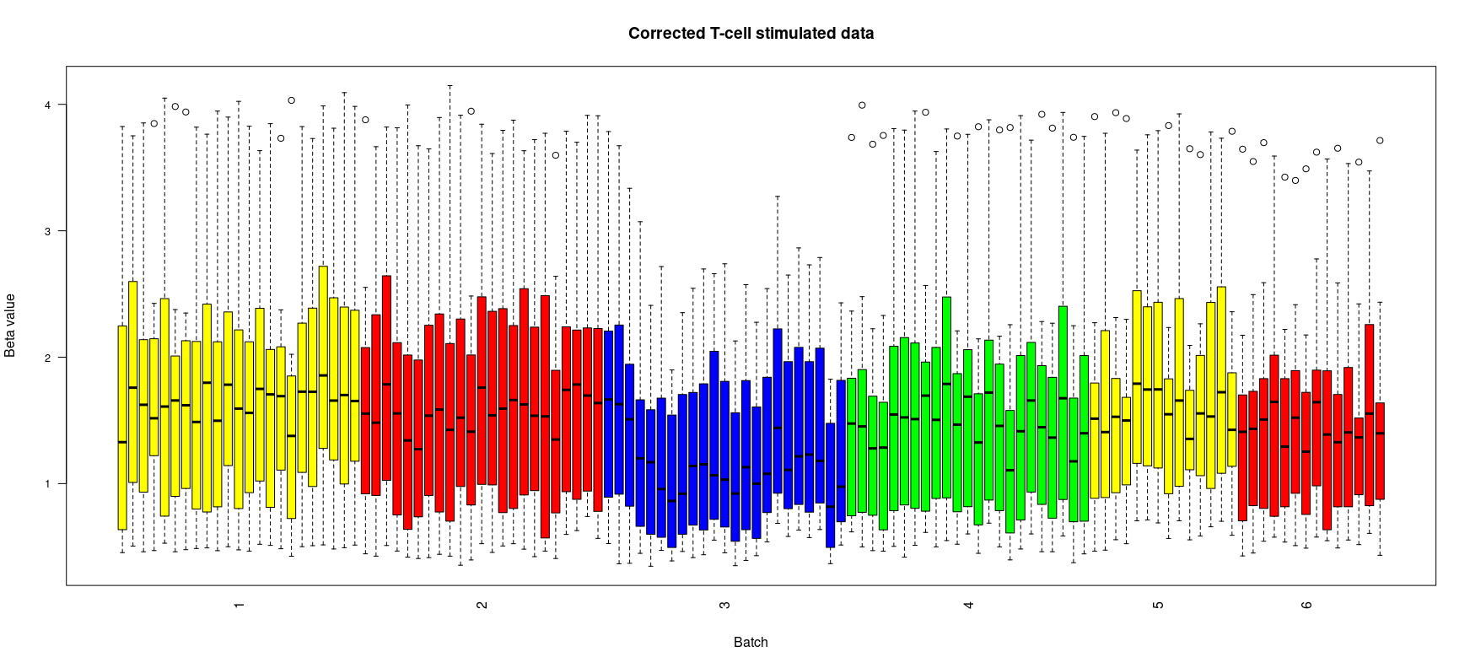

Slide 32
out$delta ; out$p.val
[1] 0.9616317
[1] 0.081
> ((out$varPCg1-out$varPCu1)/out$varPCg1)*100
[1] 12.48135

Slide 33
CytofBatchAdjust was used on the Stimulated data .
Two settings were used on CytofBatchAdjust(80p,95p)
Diagnostic plots for both are in the files
Marker Intensity plot and MD plot post CytofBatchAdjust(95p) are in the following slides

Slide 34
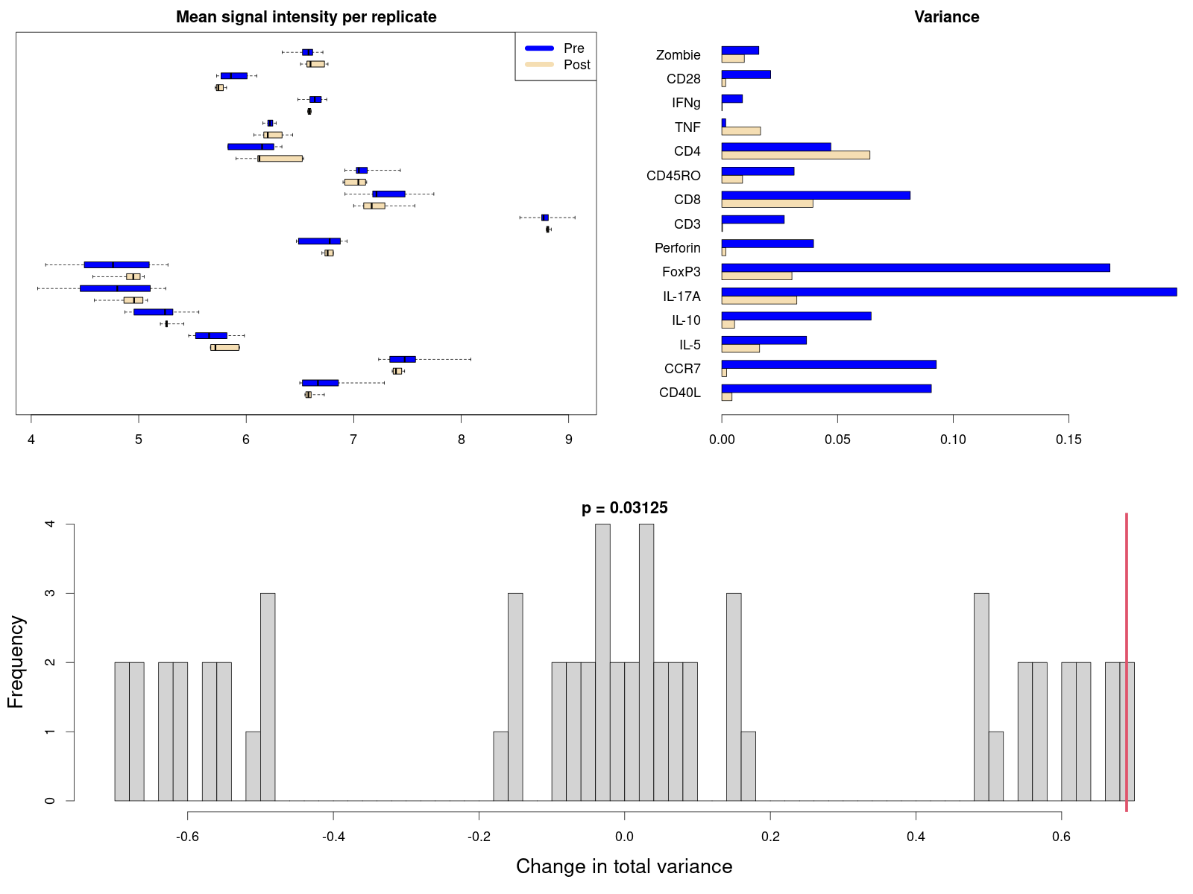
Diagnostic plots-CytofBatchAdjust-80p

Slide 35
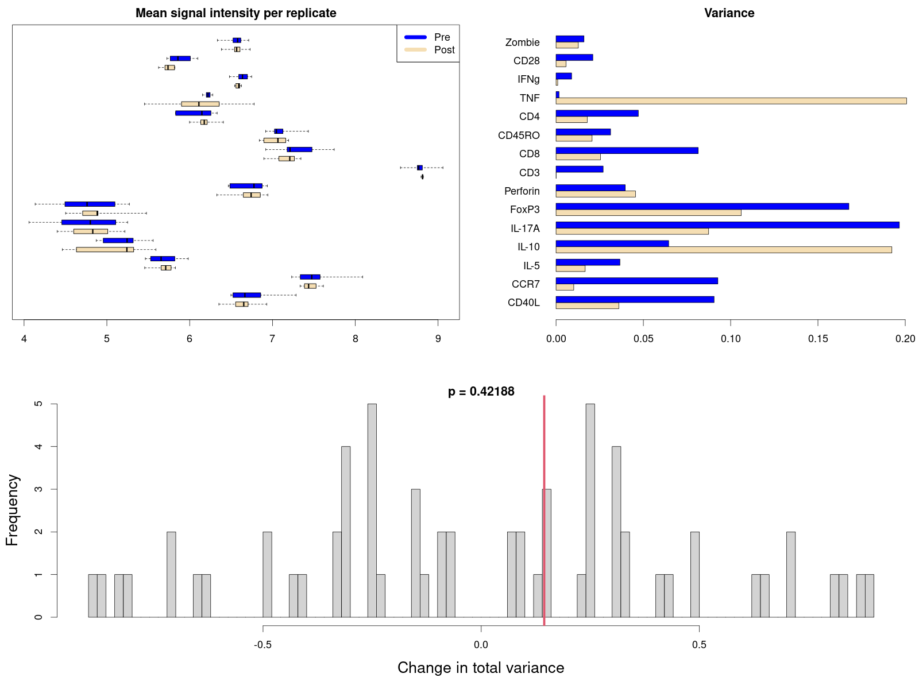
Diagnostic plots-CytofBatchAdjust-95p

Slide 36
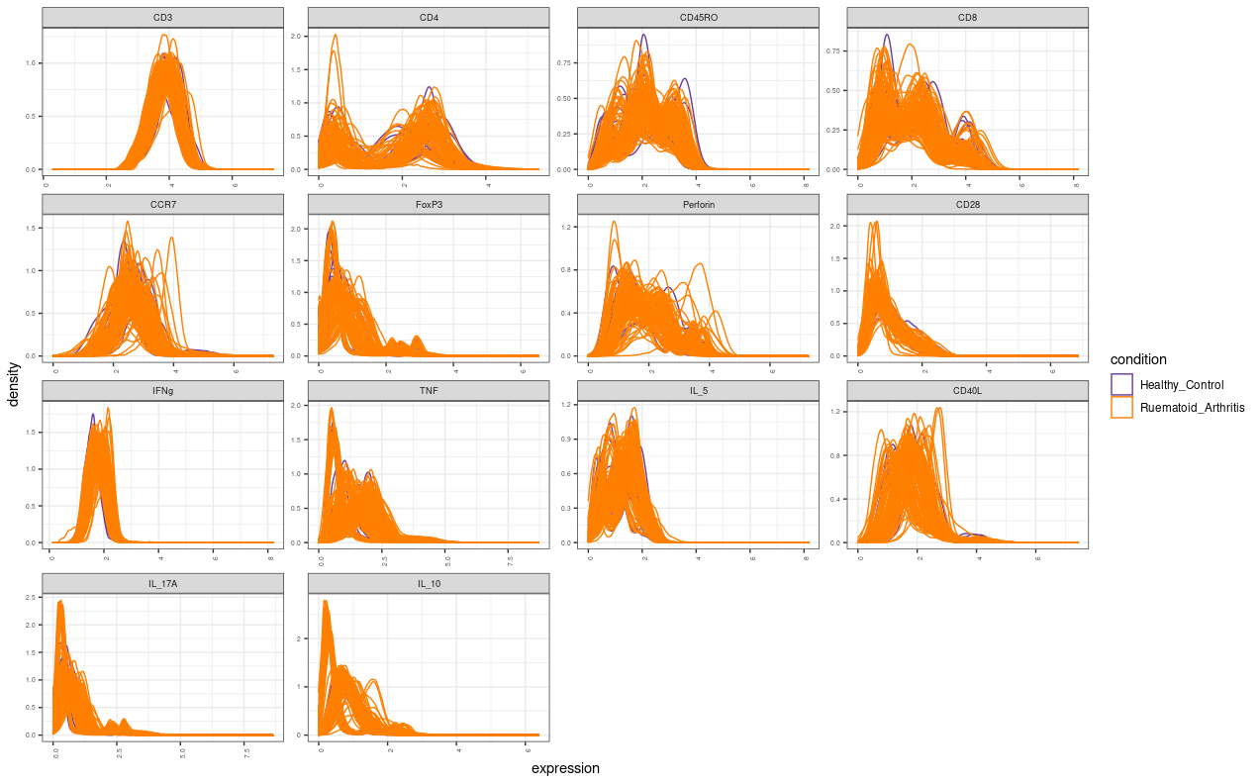
Maker Intensity-95p plot

Slide 37
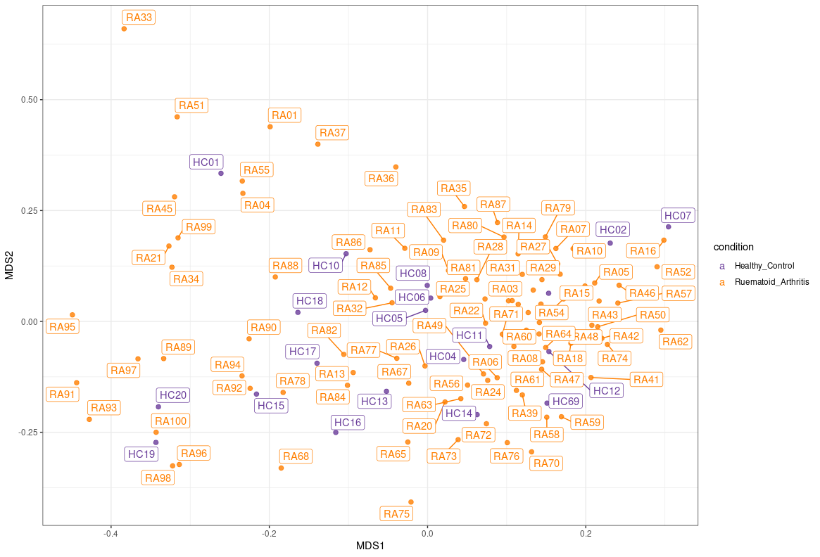
Comparing slide 7 and 35,in slide 35 HC samples are clustered more closely and towards left corner.
MD plot

Slide 38
Stimulated-Batch Number

Slide 39
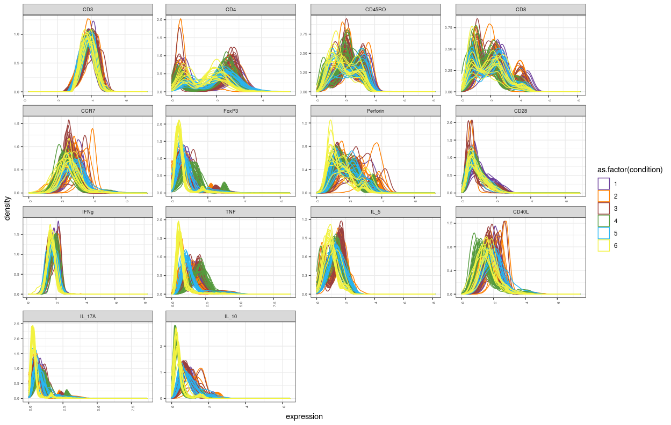

Slide 40
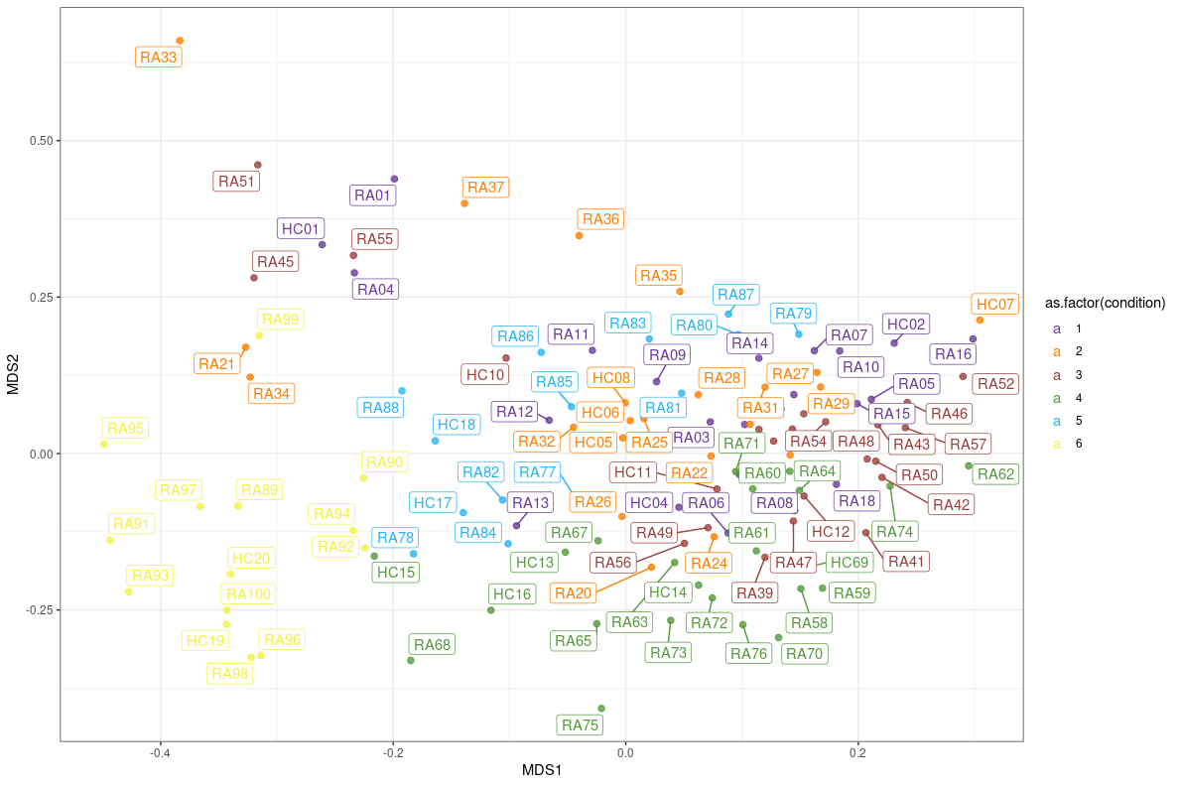

Slide 41
Stimulated(80p)-RA/HC

Slide 42
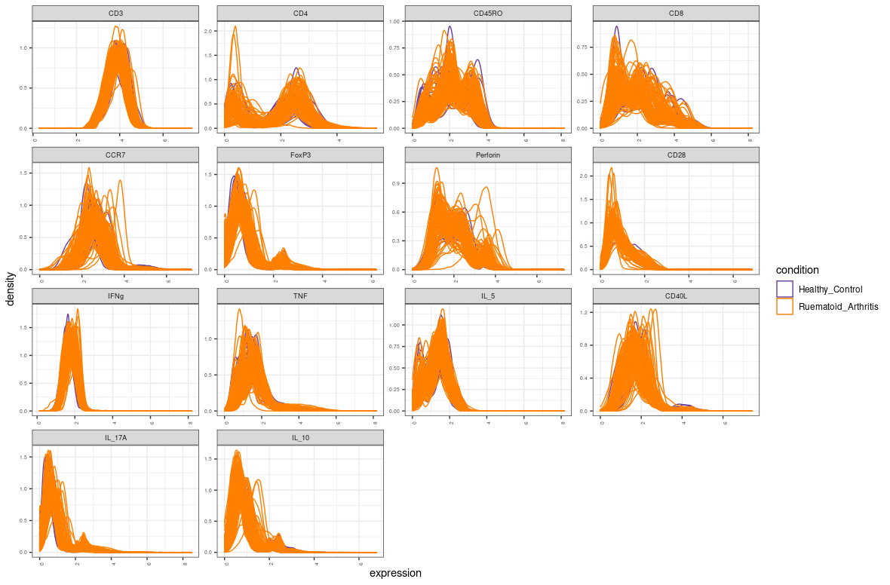

Slide 43
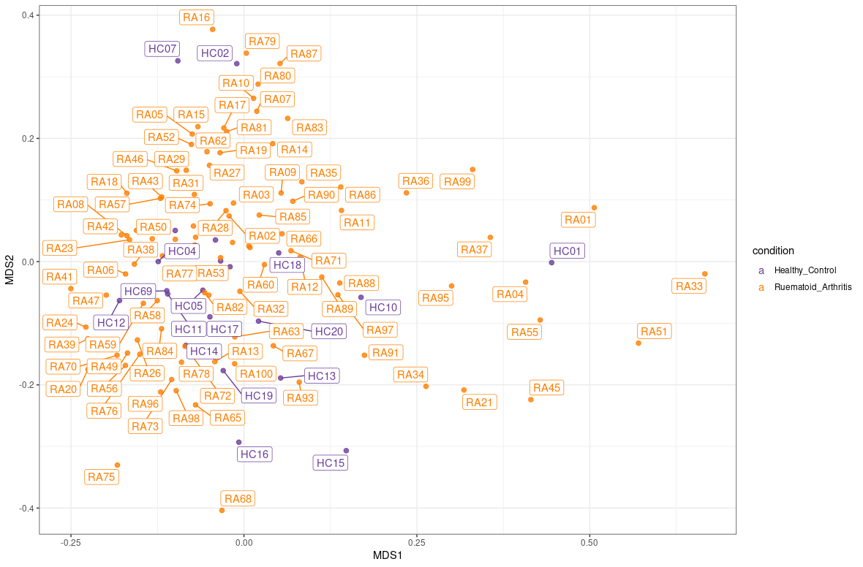

Slide 44
Stimulated(80p)-Batch Number

Slide 45
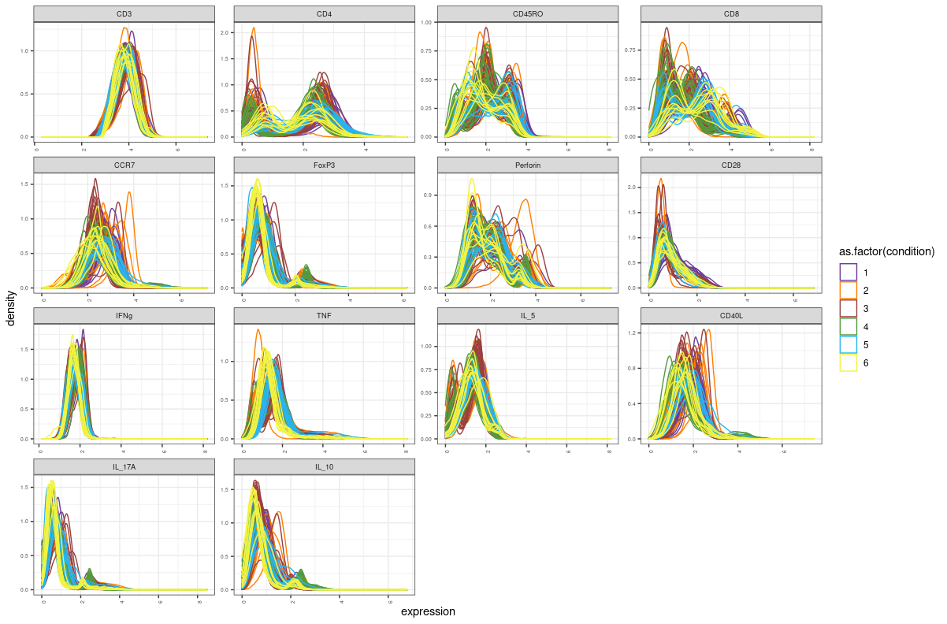

Slide 46
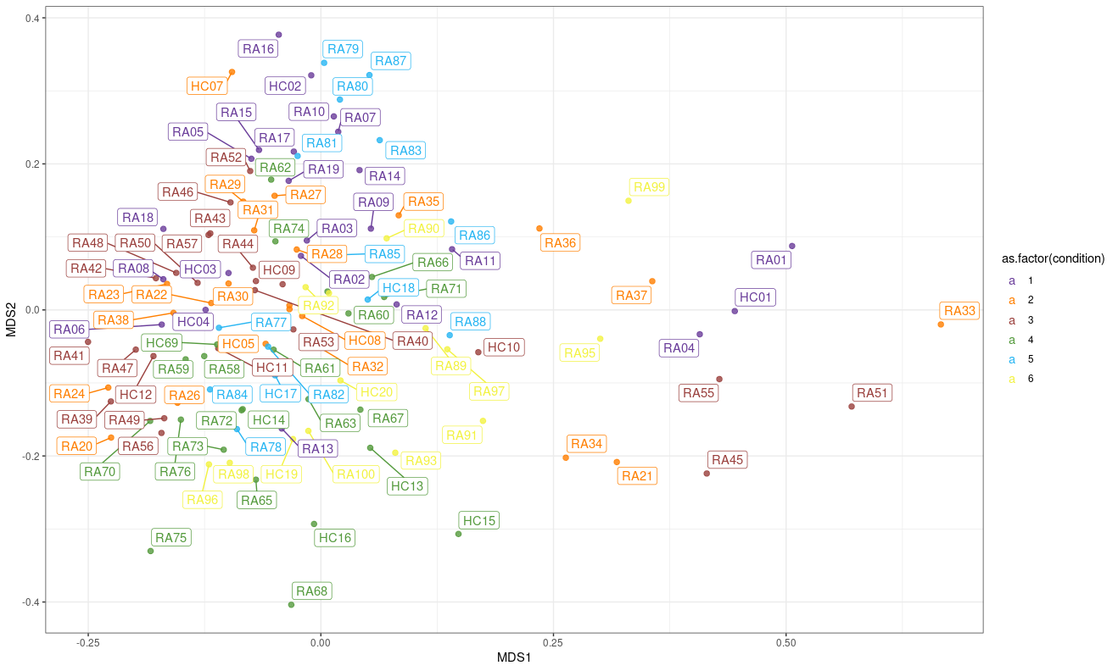

Slide 47
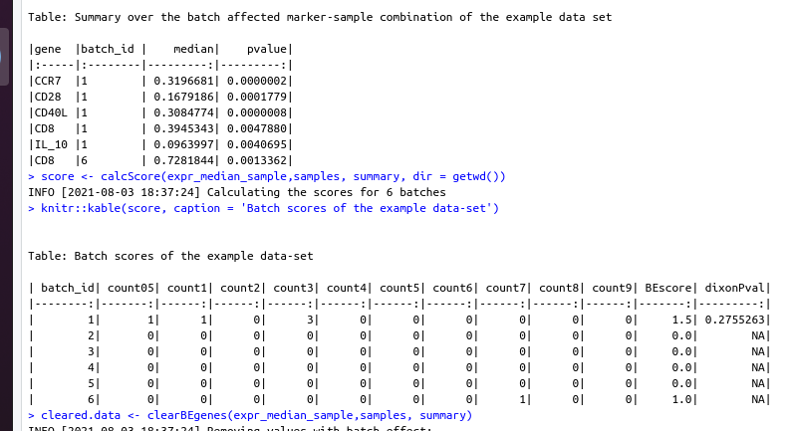
After batch effect correction by CytofBatchAdjust

Slide 48
Afte correction with CytoNorm

Slide 49
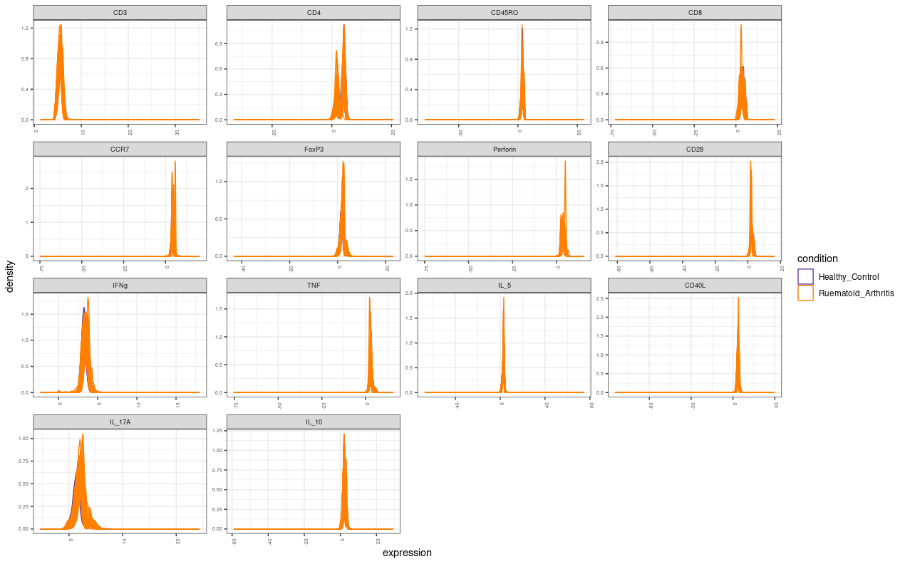

Slide 50
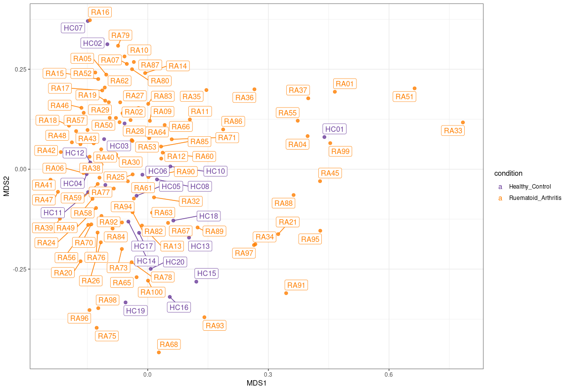

Slide 51
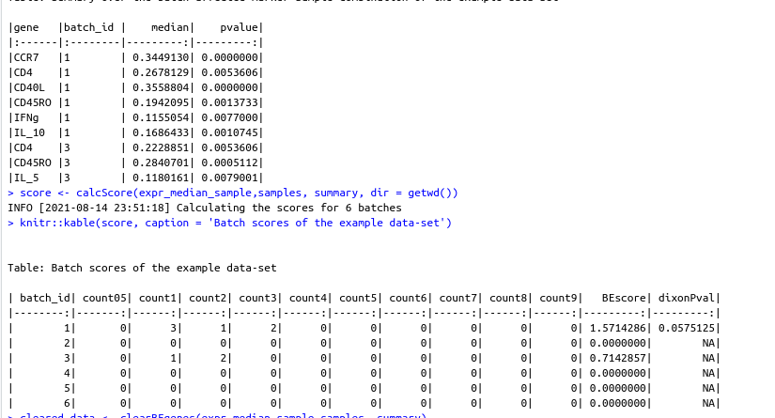

Slide 52
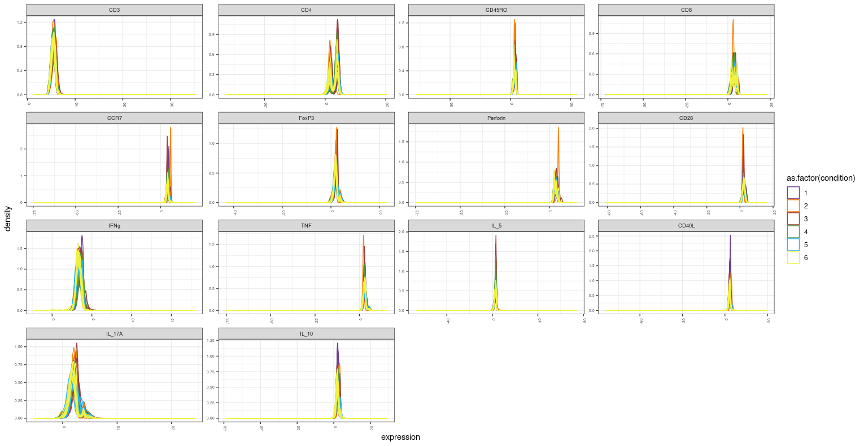

Slide 53
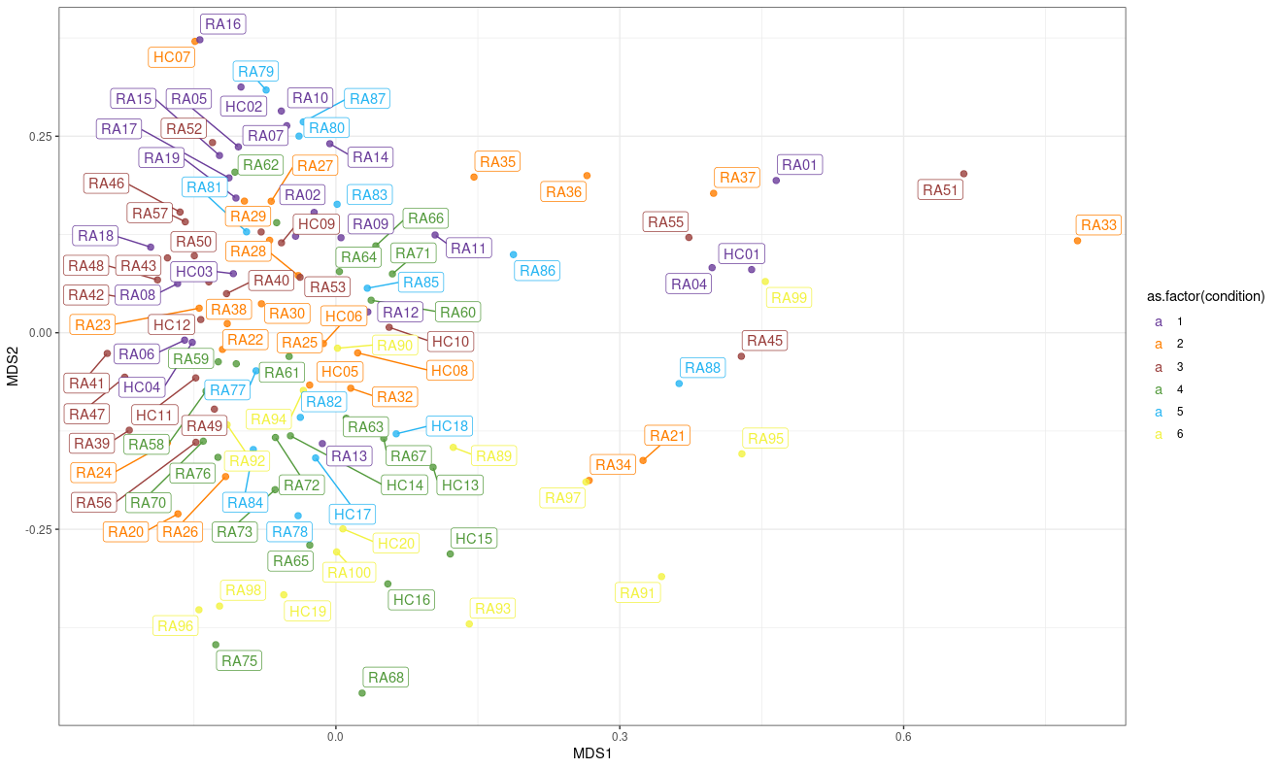

Slide 54
UNSTIMULATED

Slide 55
CytofBatchAdjust

Slide 56
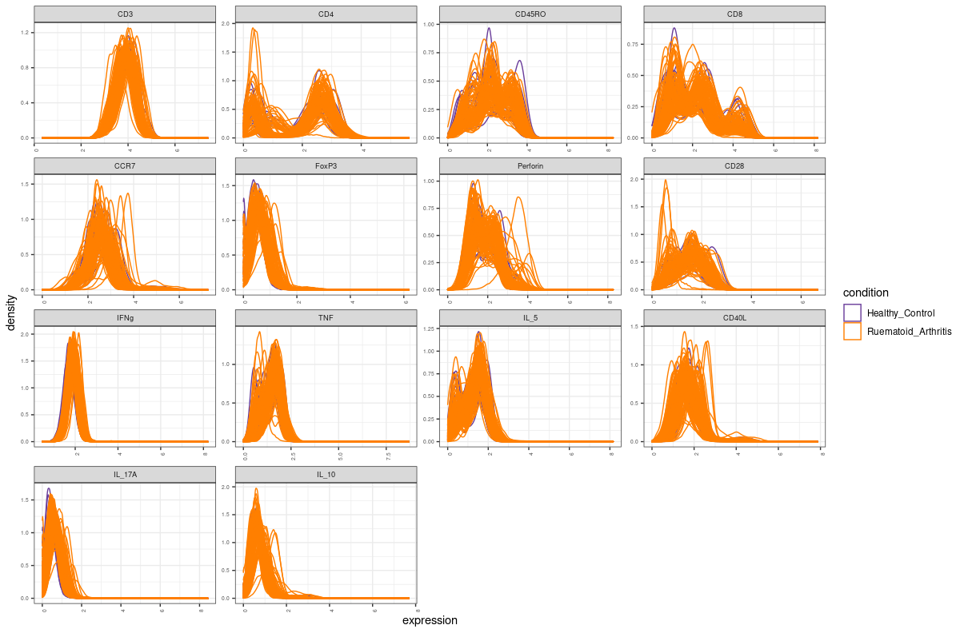

Slide 57
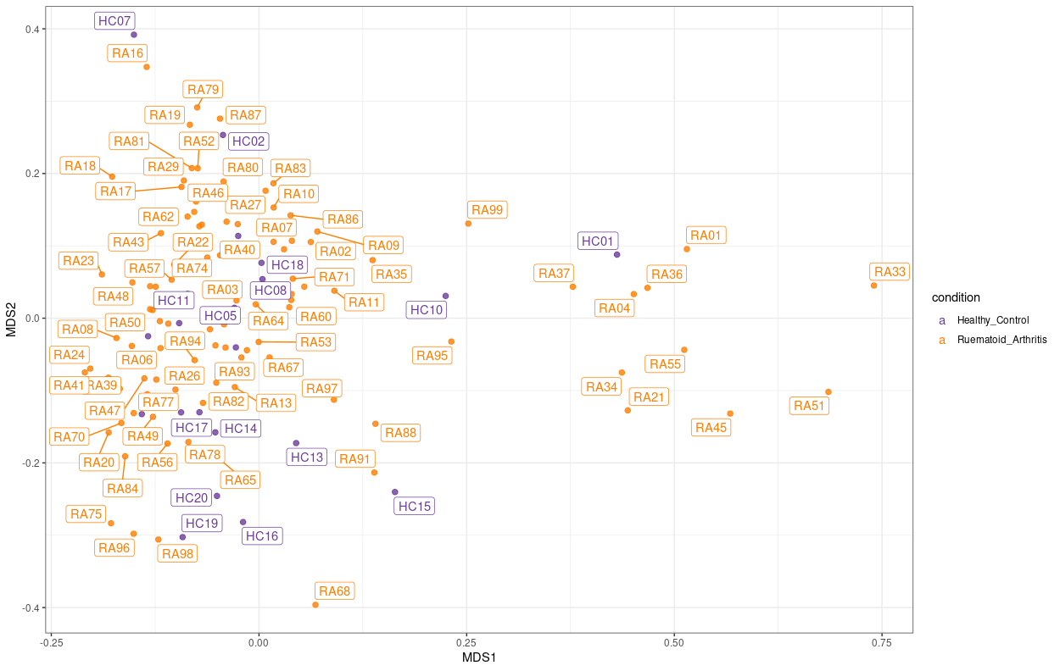

Slide 58
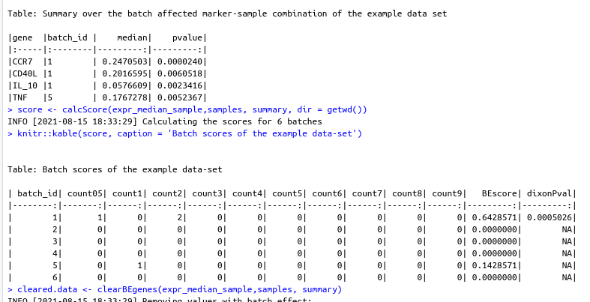

Slide 59
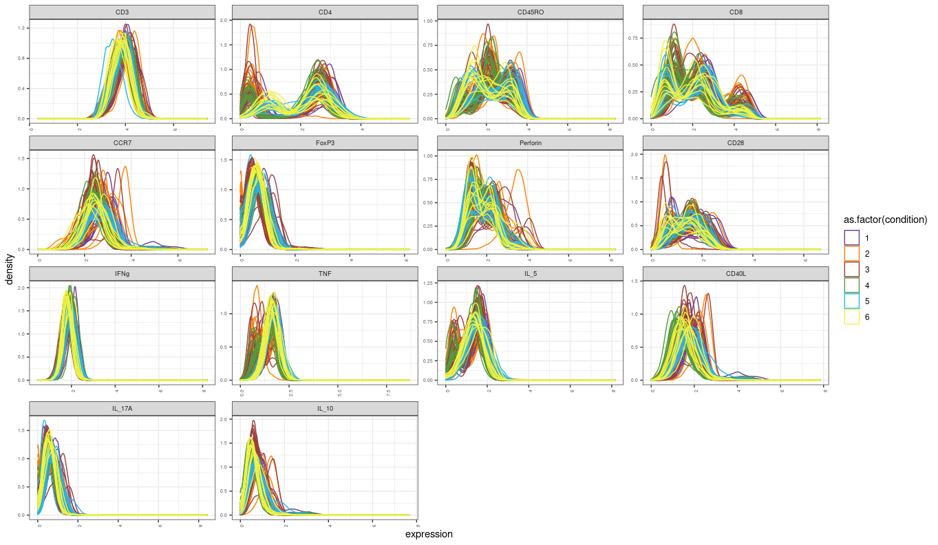

Slide 60
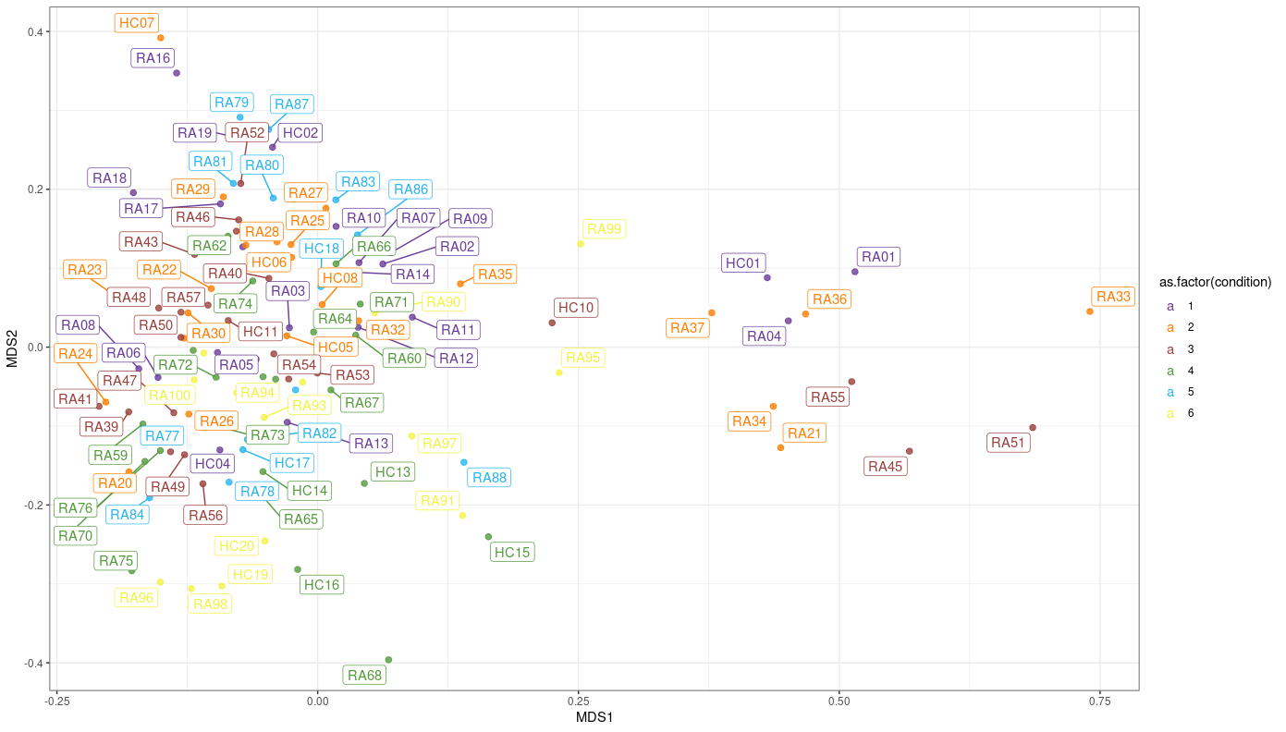

Slide 61
UNSTIMULATED CytoNorm

Slide 62
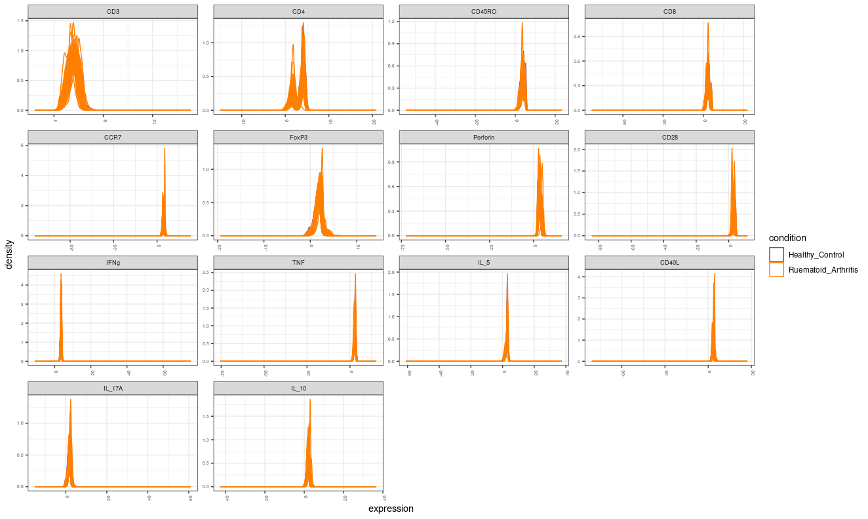

Slide 63


Slide 64


Slide 65


Slide 66


